Slide 1
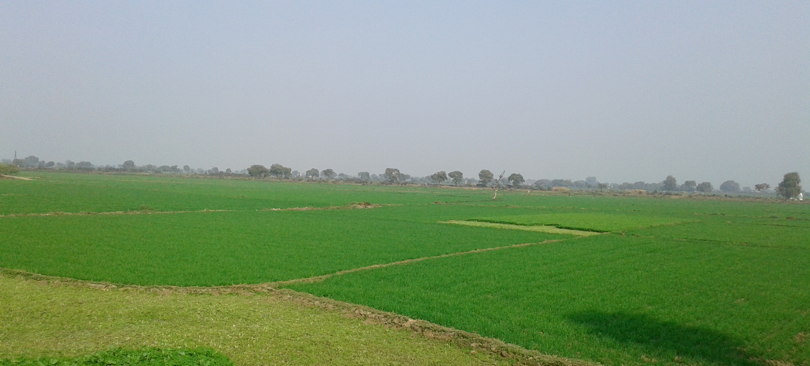

KRISHI FREAK
(IIIT-BANGALORE)
KAVISH AGNIHOTRI
JAGMEET SINGH
SHEFALI BEDARKAR
JITESH NEMADE
HARSHKUMAR PADHYA
AMANDEEP GOYAL

Slide 2
Problem Statement
Estimation of crop yield using model ICT tools which is quick and reliable for making a realistic plan for procurement and to compensate farmers for yield loss if any.
Government of Bihar
Agriculture & Rural Development.
Organization
Domain

Slide 3
About Crop Yield Prediction
Crop yield prediction is of great importance to global food production. Policy makers rely on accurate predictions to make timely import and export decisions to strengthen national food security.

Slide 4
Solution Approach
Designed a deep neural network approach that took advantage of state-of-the-art modeling and solution techniques.
Flask web service for the integration of front end and back end environment.
Developed a dynamic front end.
Hosted on AWS server using docker (containerization).

Slide 5
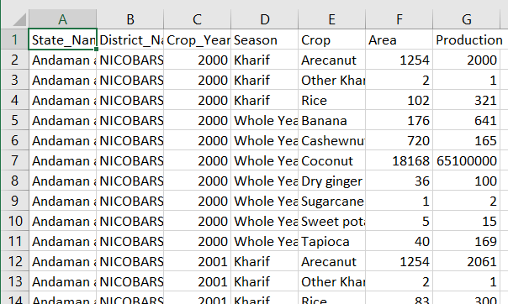
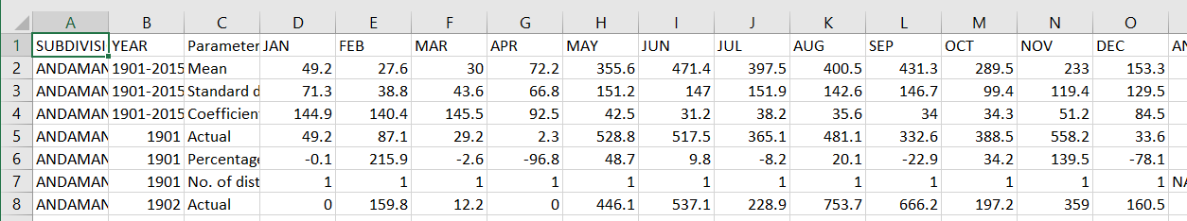
Dataset
Data source - data.gov.in
We merged the two dataset.

Slide 6
Technology
Front End - HTML, CSS, Javascript, Bootstrap.
Back End - Python for deep neural network.
Integration of front end & backend - Flask.
Docker - AWS

Slide 7
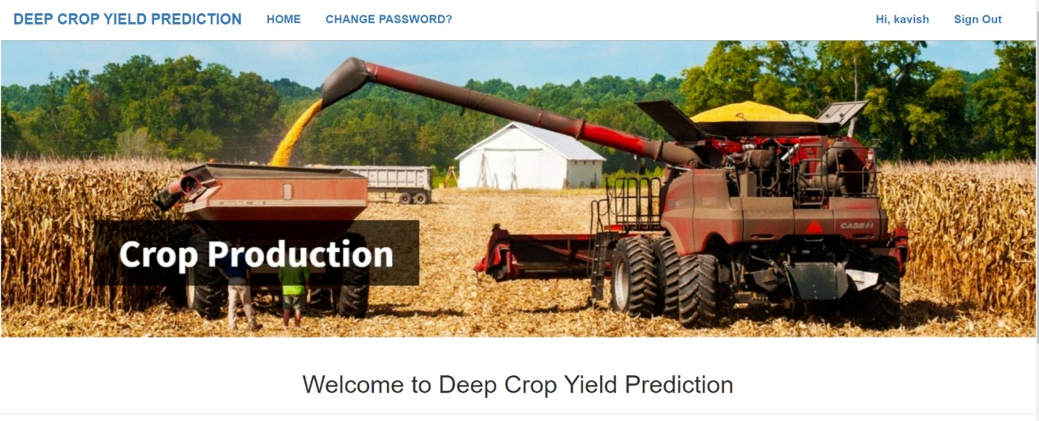
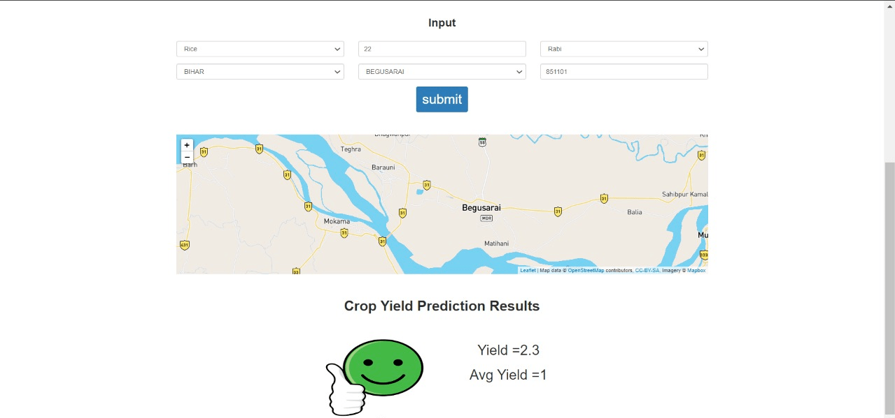
Front End
(HTML,CSS,JAVASCRIPT,BOOTSTRAP.)

Slide 8

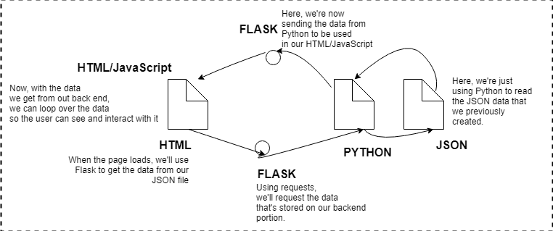
Environment to share data b/w frontend and backend.
Data fetch from frontend and return the same to backend by using json object.
Need to call already defined API to collect and resend data from one end to other where flask web service act as an intermediate.

Slide 9
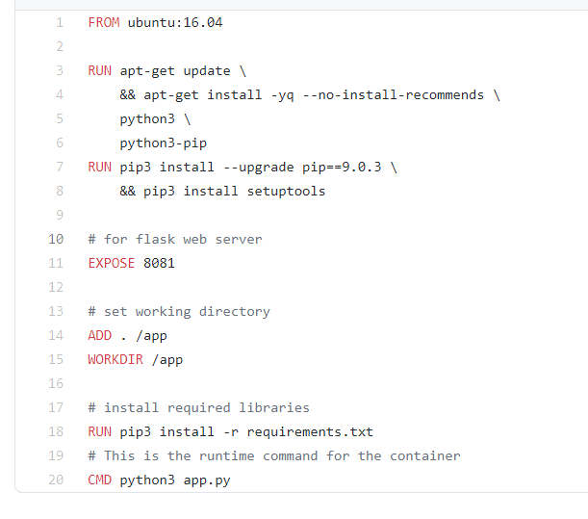
AWS & Docker

Slide 10
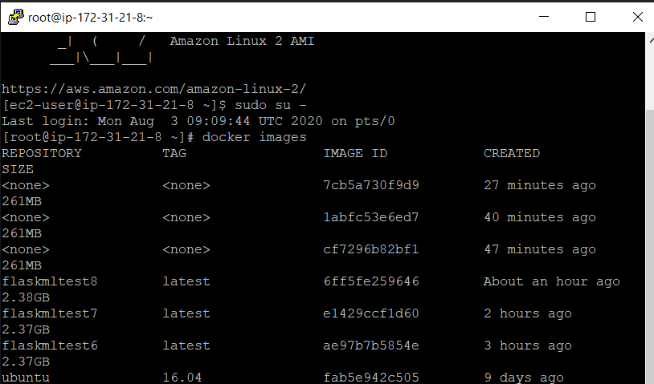
Docker Images

Slide 11
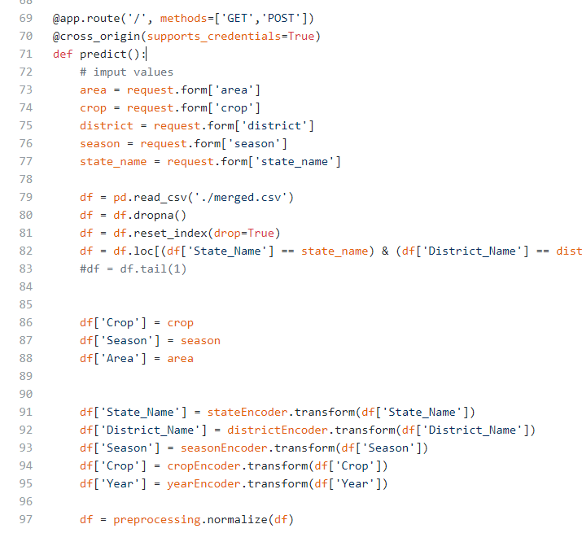
Handling API Request

Slide 12
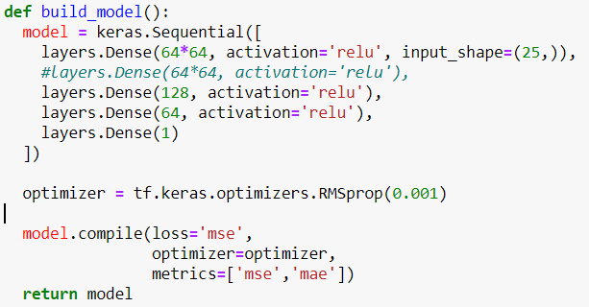
Backend
Neural Network Model Architecture
MODEL: - Deep Neural Network
TOOLS:- Tensorflow, Sklearn ,
Pandas
TRAINED DATASET:-60000
ACCURACY:-
Mean Absolute error = 37
EPOCH :-50

Slide 13
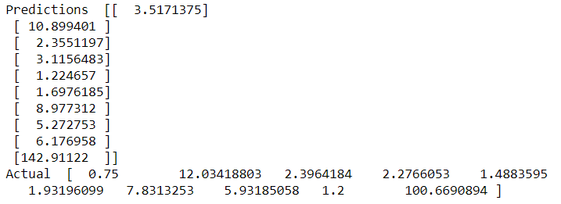
Execution

Slide 14
Future Work
Collecting more data about factors affecting crop yield which will be additional features to our model
Irrigation Data
Temperature
Atmospheric humidity
Wind velocity
Soil Fertility
Ground water level
Farming technique used
Once the data collected crossed particular threshold the recursive triggering can be done for model training using Continuous integration & Continuous deployment.

Slide 15


Slide 16


